Slide 1

Price And Availability of Flats For Rent Data Analysis
Analyzing the Influence of Various Features on Apartment Types and Their Prices by
Tarun
Sandhya
Sahithi

Slide 2
Introduction:
I
Purpose of the Analysis:
To understand the factors influencing Flat type prices.
To identify which features have the most significant impact on the pricing of type of apartments.
Overview of the Dataset:
The dataset includes various features such as Apartment Type, Area, City, Price etc…
The data has been sourced from [Makaan]
Scope of Analysis:
Exploring the relationship between Apartment type and their Prices.
Exploring the relationship between Apartment prices based on the Areas and City.
Helps consumers make informed Rental decisions.
Identifying the patterns in the data.

Slide 3
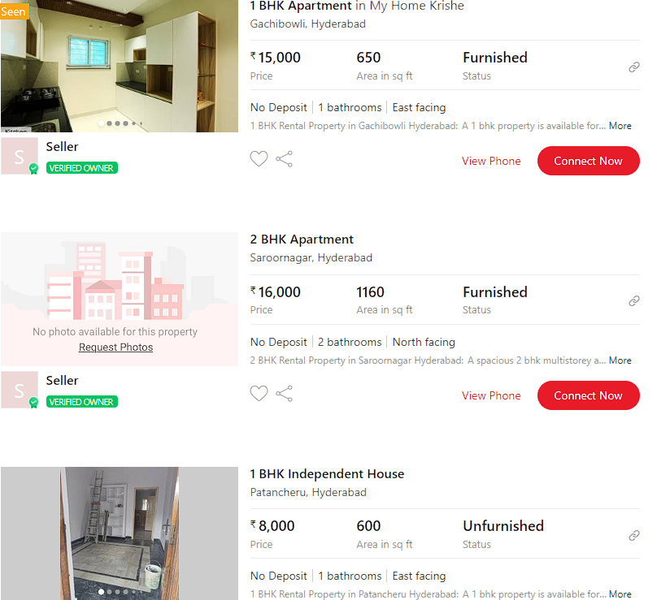
Website:
Website used for scrapping:
URL: https://www.makaan.com/

Slide 4
Data Collection
For real time analysis , data is scrapped from Makaan.com We For real time analysis , data is scrapped from Makaan.com Website For real time analysis , data is scrapped from Makaan.com Website
For real time analysis , data is scrapped from Makaan.com Website
Makaan Website For rental properties
Scrap the data using BeautifulSoup.
Scrape the data for multiple URLs
Extract the features
Save it to .csv file

Slide 5
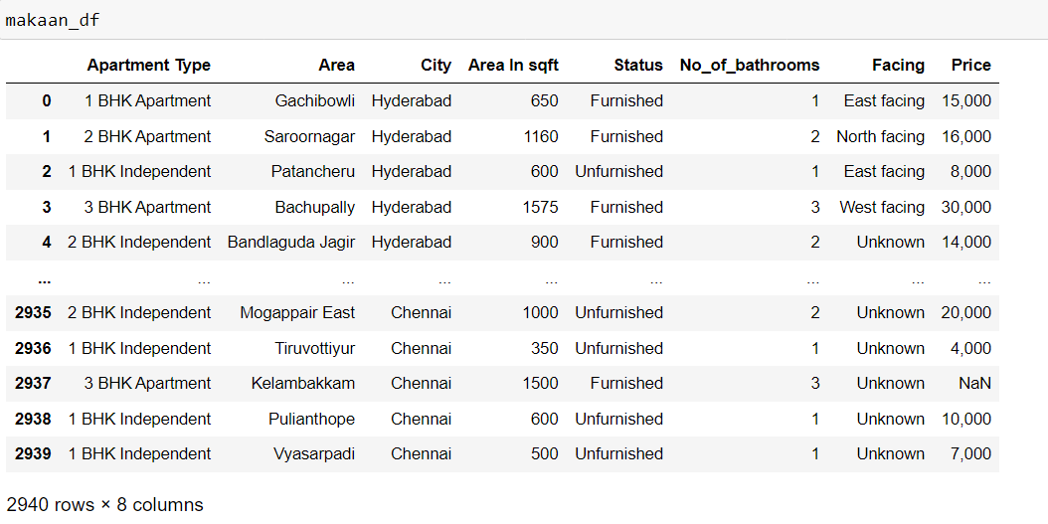
Exploratory Data Analysis (EDA)
Data obtained after scrapping:
Web scrapping is done using BeautifulSoup library in which data is pulled out of HTML code. Makaan data in Data frame:
Obtained 23,520 datapoints after scraping.
It contains 8 columns and 2940 rows.

Slide 6
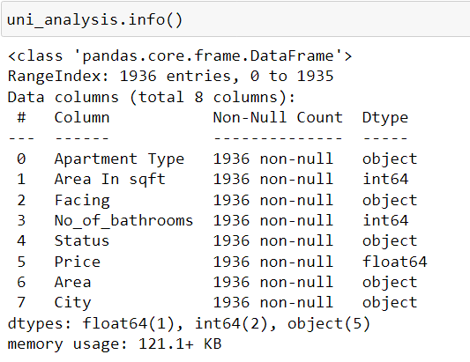
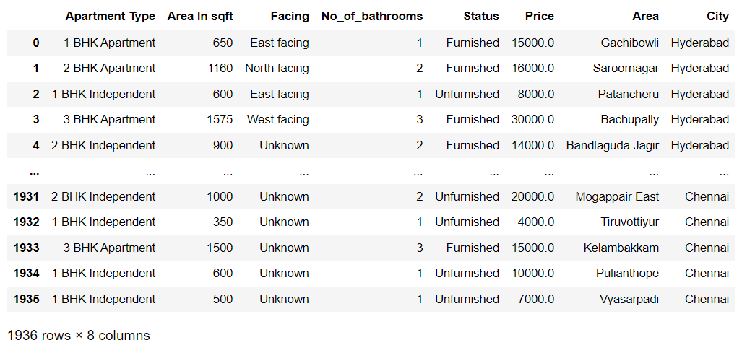
Data Cleaning:
Data cleaning is the process of fixing or removing incorrect, corrupted, incorrectly formatted, duplicate, or incomplete data within a dataset.
Removing unnamed column & duplicates and converting datatypes (after cleaning) :
After the data cleaning we got 1936 rows and 8 columns

Slide 7
Data Analysis and Visualization
Visualization id done using….
a) Uni-variate analysis: The term univariate analysis refers to the analysis of one variable. You can remember this because the prefix “uni” means “one.”
The purpose of univariate analysis is to understand the distribution of values for a single variable.
b) Bi-variate analysis: Bivariate data involves two different variables, and the analysis of this type of data focuses on understanding the relationship or association between these two variables.
c) Multivariate analysis: Multivariate data refers to datasets where each observation or sample point consists of multiple variables or features. These variables can represent different aspects, characteristics, or measurements related to the observed phenomenon. When dealing with three or more variables, the data is specifically categorized as multivariate.

Slide 8
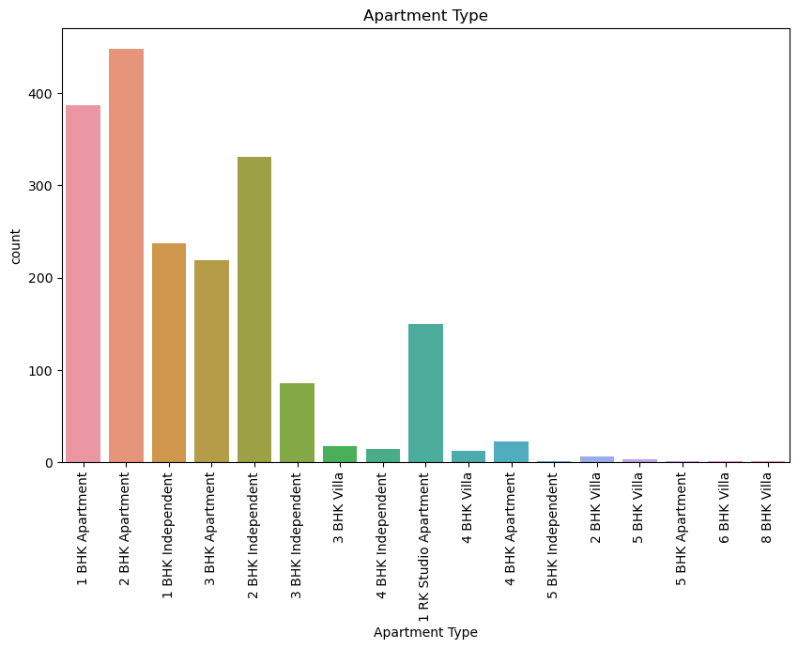
Uni-Variate analysis
Observations:
This indicates that 2 BHK and 1 BHK units are the most frequently available for rent.
Apartments (both 1 BHK and 2 BHK) are more prevalent than independent houses for rent, suggesting a higher availability in the rental market compared to independent houses.
In summary, the countplot observations reveal a diverse range of rental property types with a clear dominance of 2 BHK and 1 BHK apartments, reflecting typical market demand and availability patterns in rental housing.

Slide 9
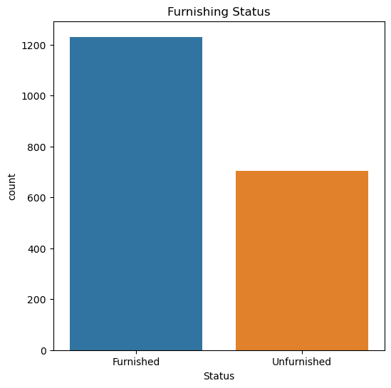
Observations:
The CountPlot clearly shows that the majority of available apartments/Villas/Independent houses for rent are furnished.
The above plot shows the CountPlot for furnishing status

Slide 10
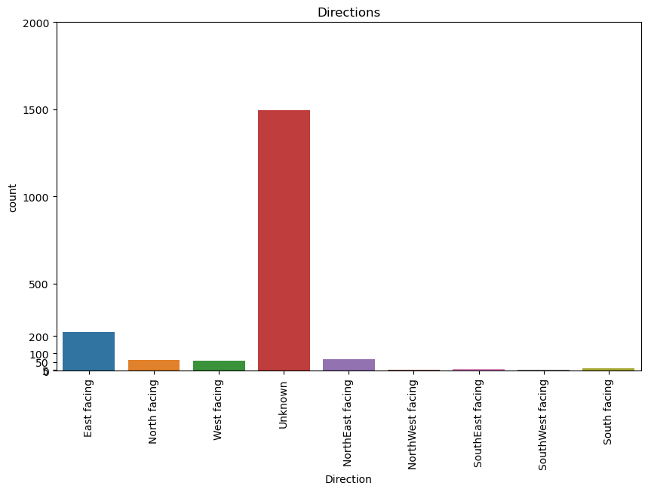
Observations:
Unknown: With a significant count, it suggests a need for clearer communication or exploration of specific orientation details by landlords or listing providers.
East Facing:This orientation appears relatively more available, possibly due to its popularity for tenants seeking morning sunlight and cooler afternoons.
SouthEast, NorthWest,South, SouthWest Facing:These orientations are the least represented, suggesting niche availability that may not align with broader tenant preferences or possibly influenced by local geographical constraints.

Slide 11
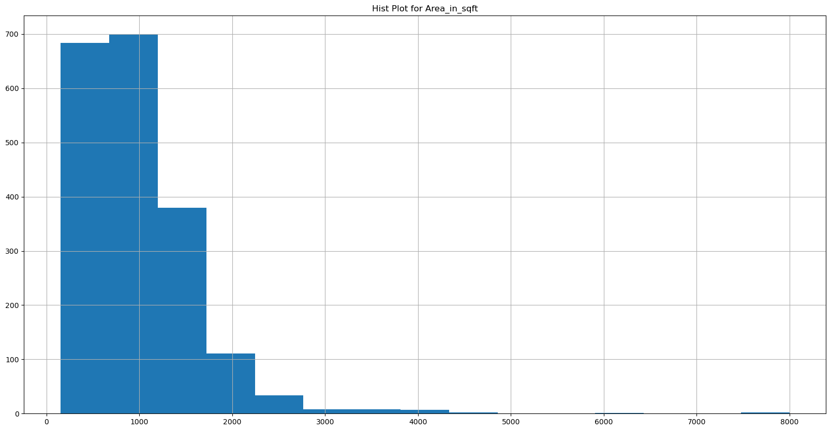
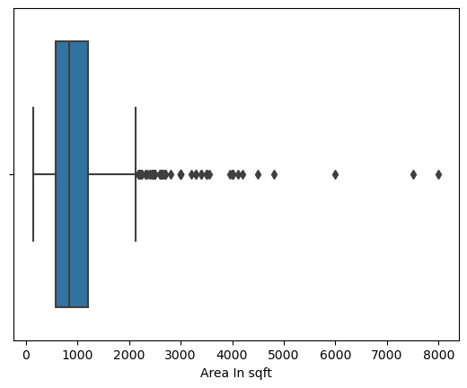
Histogram and Box plot for Area in sqft:

Slide 12
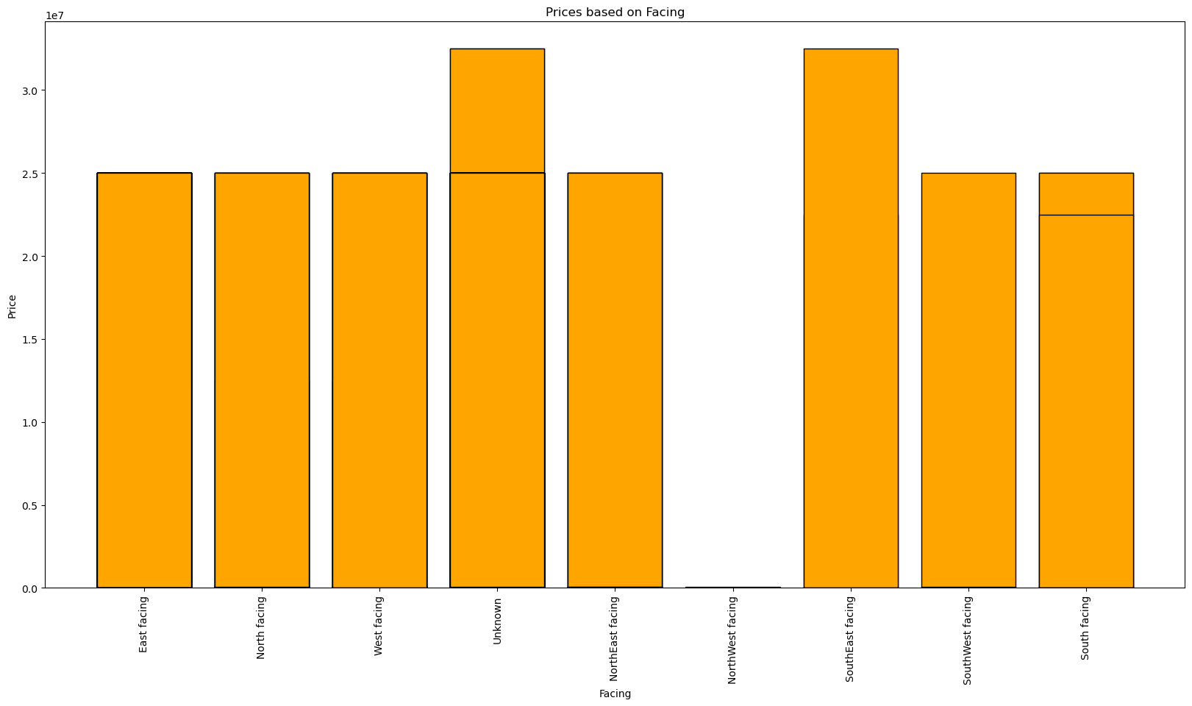
Bi-Variate Analysis
Observations:
The most expensive houses are those facing SouthEast.
The least expensive houses are those facing NorthWest.
Analysis on relation between Price and Facing

Slide 13
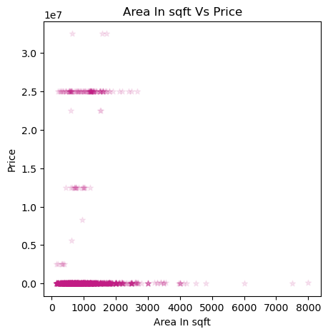
.
Analysis on Relation Between Price and Area in sqft,City
Observations:
There is a positive correlation between the area of a house and its price. This means that, as the area of a house increases, the price of the house also tends to increase.
There is a lot of variation in the data. This means that there are many houses that do not fit the trend line. For example, there are some houses that are large but relatively inexpensive, and there are some houses that are small but relatively expensive.

Slide 14
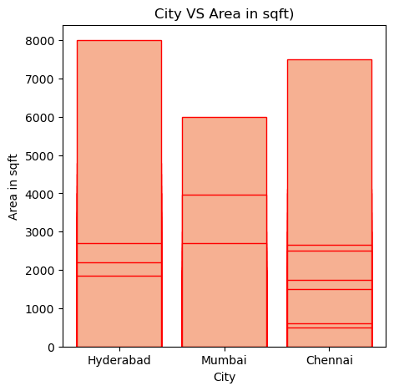
Observations:
Hyderabad has the largest area, followed by Chennai and then Mumbai.

Slide 15
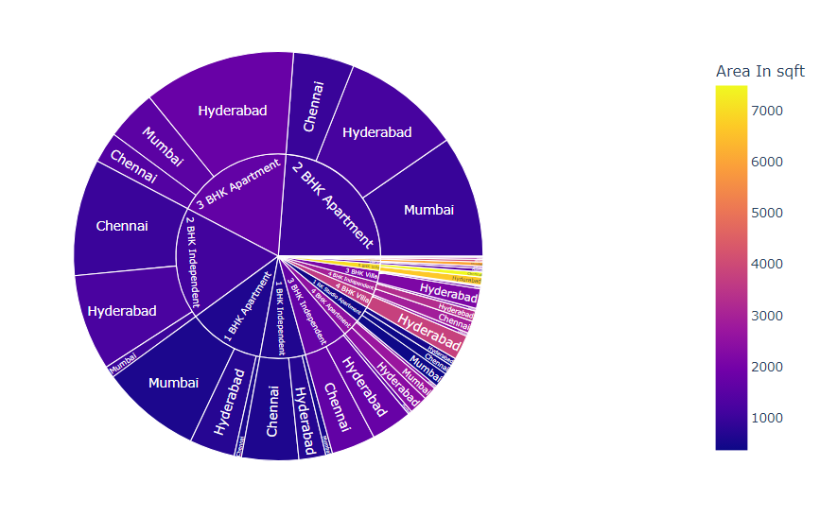
Analysis on Apartment Type and its Area in sqft in each City
Observations:
The largest area, 7500 sqft, is found in 5 BHK villas for rent in Chennai, followed by 6666 sqft in Hyderabad.
1 BHK apartments and independent houses available for rent in all cities generally have smaller areas, typically less than 1000 sqft.
It is also observed that 1 BHK, 2BHK, 3BHK apartments and independent houses are mostly available for rent in all the cities

Slide 16
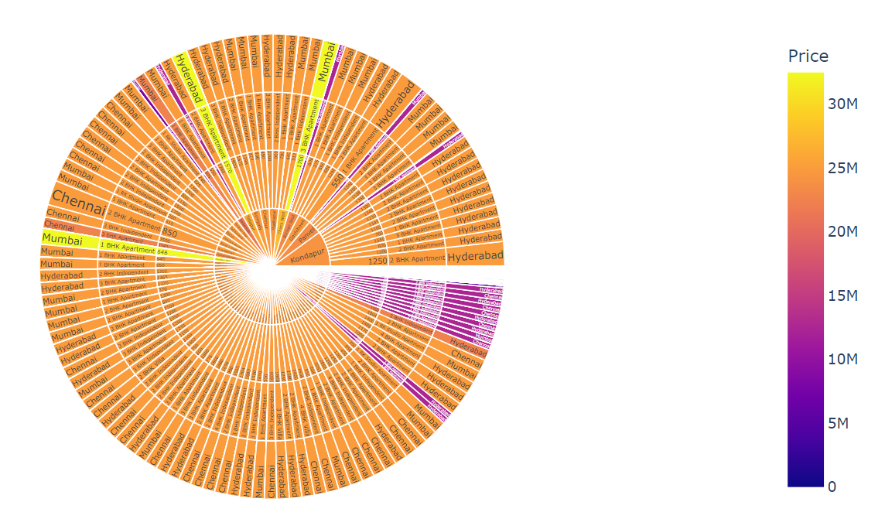
Observations
From the above plot we can say that Mumbai(Goregoan West) 1BHK Apartment Rents are higher comapred to all the areas in other cities.
We can also say that Mumbai(Goregoan West), Hyderabad(Tellapur), Mumbai(Thane West) have same prices but they differ in the size, that is 3 BHK Apartment in Hyderabad has more area compared to 3 BHK apartment in Mumbai
Comparatively, Chennai generally offers lower prices for similar-sized areas (in sqft) compared to Mumbai. Hyderabad and Chennai show similar pricing trends across most areas.
For few areas Prices are high in Hyderabad compared to Chennai and vice versa
Analysis on variation of Prices Based on Area in sqft, Apartment Type, Area,City

Slide 17
Conclusion
In conclusion, a comprehensive makaan data price analysis enables informed decision making, whether you are renting the apartment or not.
By carefully evaluating these factors, prospective tenants can make informed decisions that align with their budget, space requirements, and desired living conditions. whether it's affordability, spaciousness, or the condition of the property, Makaan.com offers a diverse range of options to cater to every individual's needs..

Slide 18

THANK YOU

